Slide 1


G2M insight for Cab Investment firm
Abishek James
20 March 2023

Slide 2

Agenda
Problem Statement
Datasets Information
Approach
EDA
EDA Summary
Recommendations

Slide 3

Problem Statement
XYZ is a private firm in US. Due to remarkable growth in the Cab Industry in last few years and multiple key players in the market, it is planning for an investment in Cab industry and as per their Go-to-Market(G2M) strategy they want to understand the market before taking final decision.
Objective: Provide actionable insights to assist XYZ firm in determining the best company for investment.

Slide 4
Dataset Information
Datasets for the analysis:
Cab_Data.csv – this file includes details of transaction for 2 cab companies
Customer_ID.csv – this is a mapping table that contains a unique identifier which links the customer’s demographic details
Transaction_ID.csv – this is a mapping table that contains transaction to customer mapping and payment mode
City.csv – this file contains list of US cities, their population and number of cab users

Slide 5
Approach
Understanding the data and Visualization.
Taking necessary data and checking the datatype.
Recognizing the number of users per company.
Finding the most expensive and least expensive cab.
Identifying the profitable company.
Investigating and testing multiple hypothesis

Slide 6
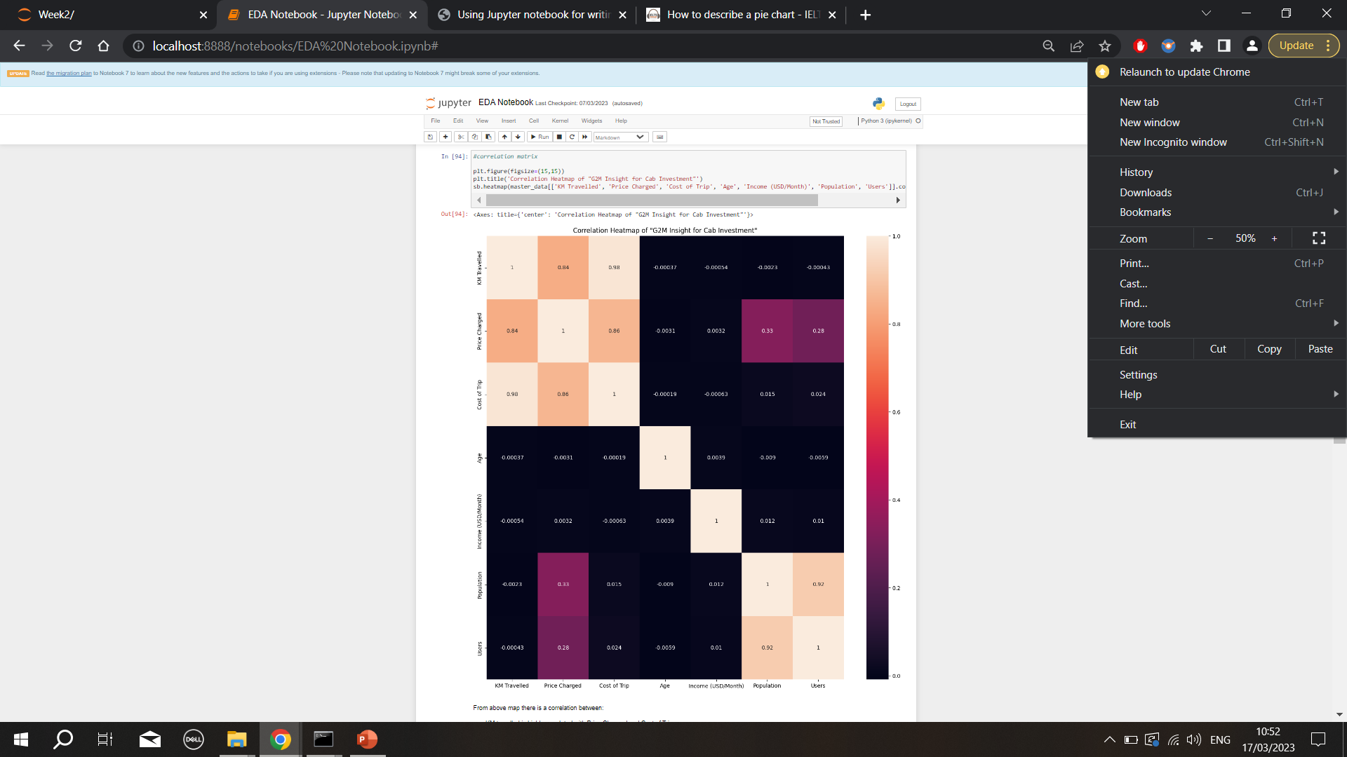
Correlation between variables
From above map there is a correlation between:
KM travelled is highly correlated with Price Changed and Cost of Trip.
Also, Users are related to population.

Slide 7
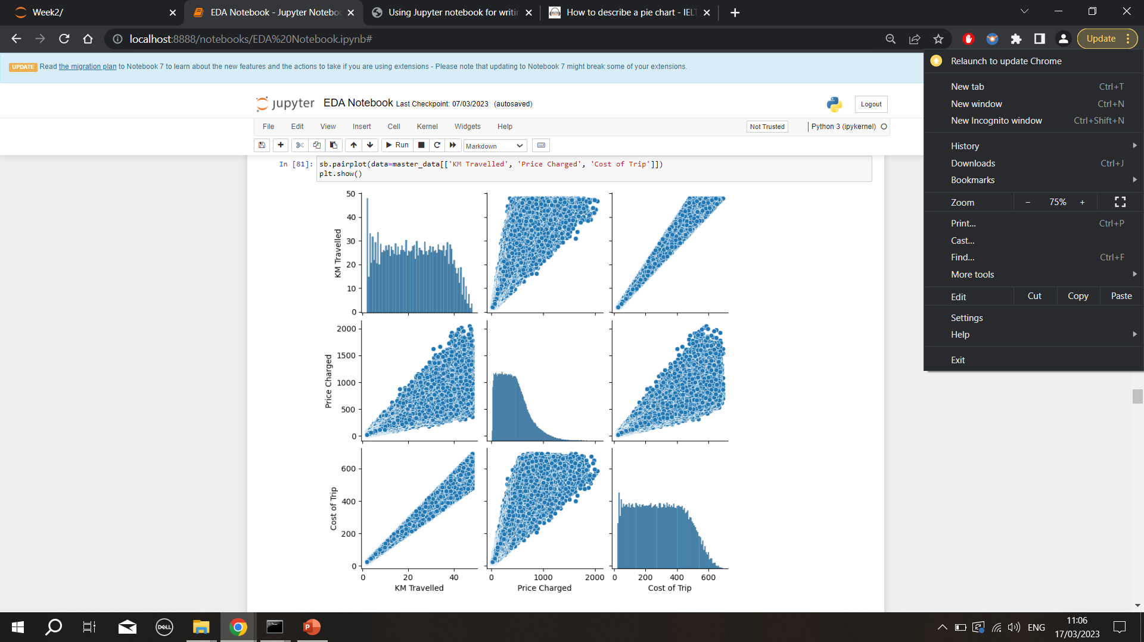
Correlation KM travelled is highly correlated with Price Changed and Cost of Trip.

Slide 8
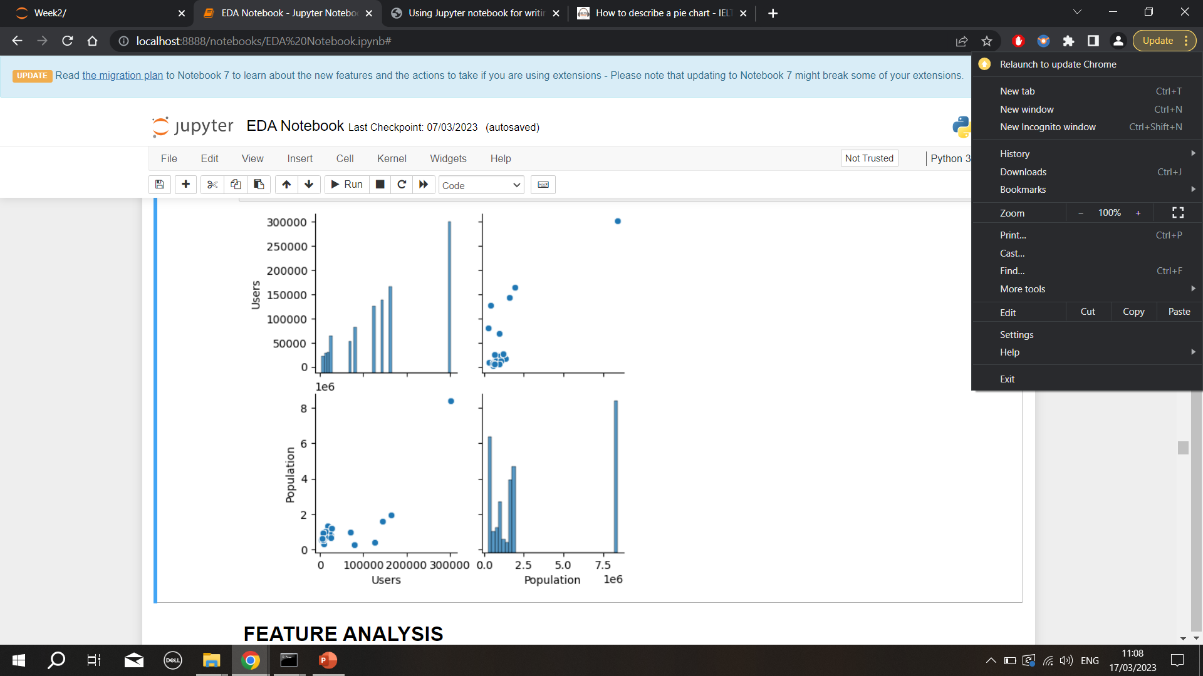
Correlation Users are correlated with Population .

Slide 9


Slide 10
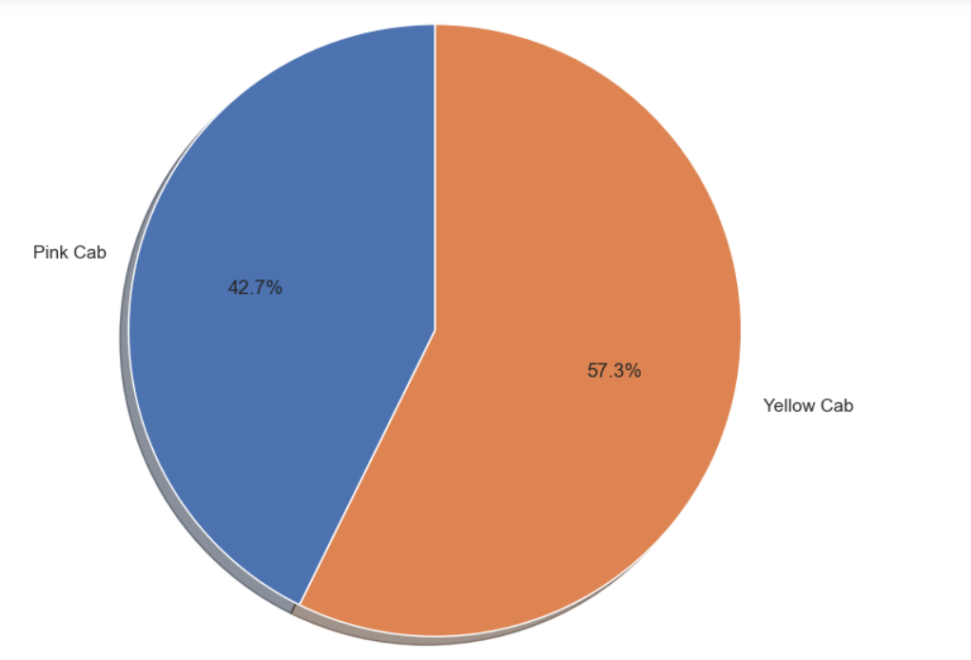
No of Users
From the pie chart it is evident that Number of yellow cab users are more than pink cab.
For Pink cab it is 42 % while Yellow cab has 57 %.

Slide 11
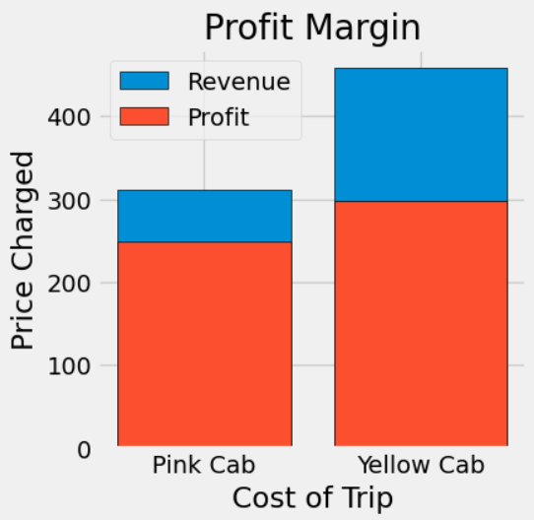
Profit Margin
In contrast to the Pink cab, the Yellow cab has a higher profit margin.
In x-axis the cost of the trip and on y-axis price charged.
This bar graph shows Revenue as well as profit are more in Yellow cab.

Slide 12
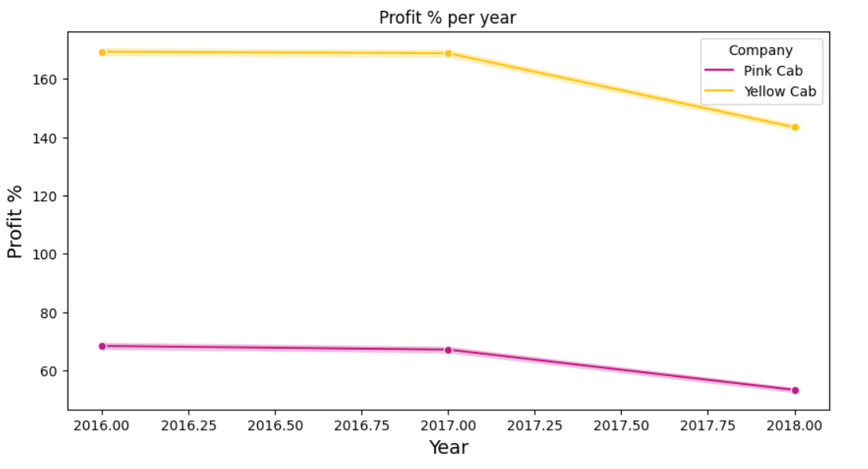
Profit in Year Time period of data is from 2016 to 2018.
From the line graph we can conclude
In comparison to 2018, both companies' profits were higher in 2016.
In the year 2018, PINK cab had higher profits than YELLOW cab.
From 2016 to 2017, the profit margin stayed consistent and it was dropped after 2017.

Slide 13
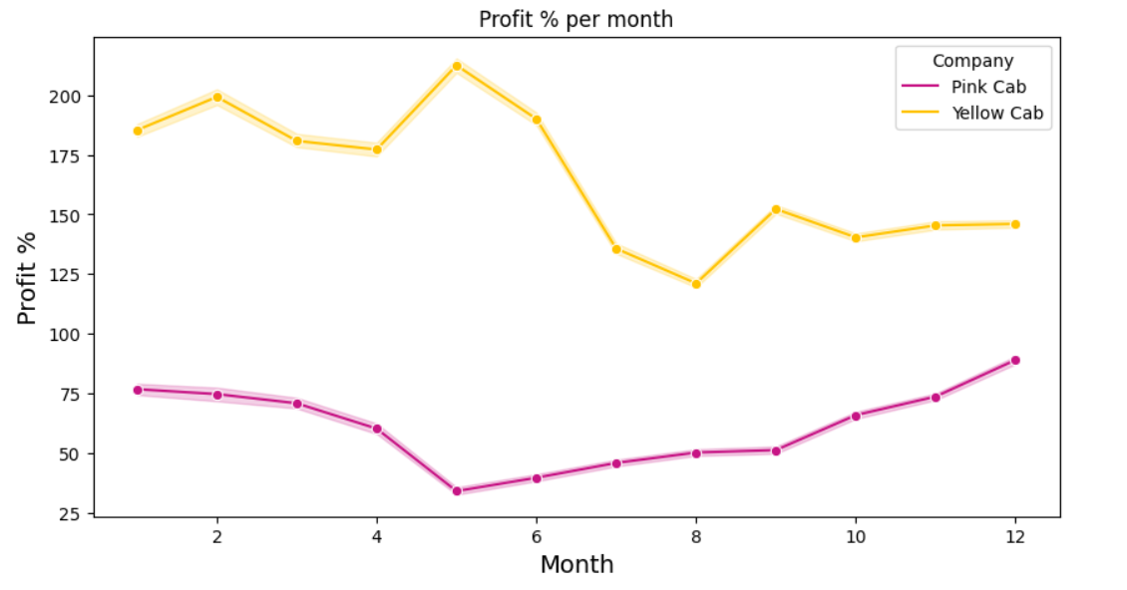
Profit in Month Time period of data is from31/01/2016 to 31/12/2018.
From the line graph we can conclude:
The middle of the year appears to have been profitable for YELLOW cab.
PINK Cab has made more profit at the beginning and end of the year.
In pink cab, profit was going up and down consistently while in yellow cab it was declined over the months and later it went up.

Slide 14
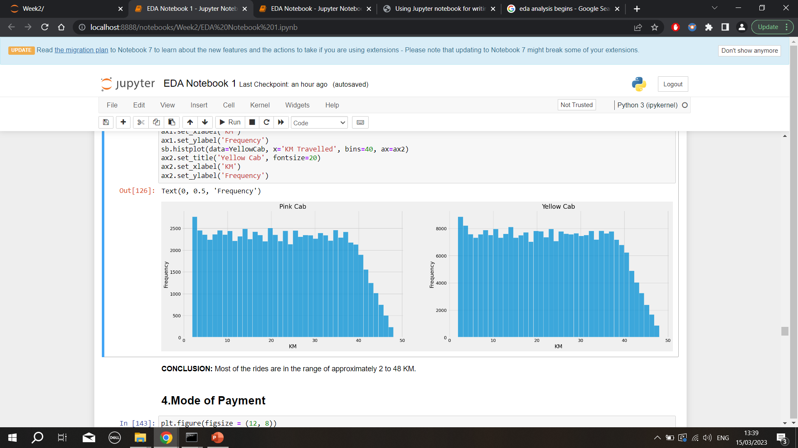
KM Travelled Distribution Number of km travelled in both cabs.
Most of the rides are in the range of approximately 2 to 48 KM.

Slide 15
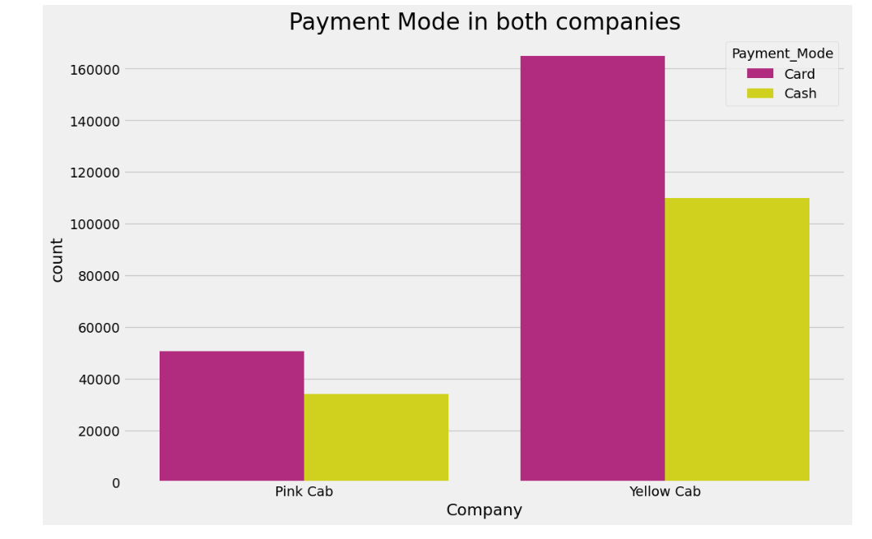
Mode of payment Users preferred to pay with a card more than cash.
Most of the rides are in the range of approximately 2 to 48 KM.

Slide 16
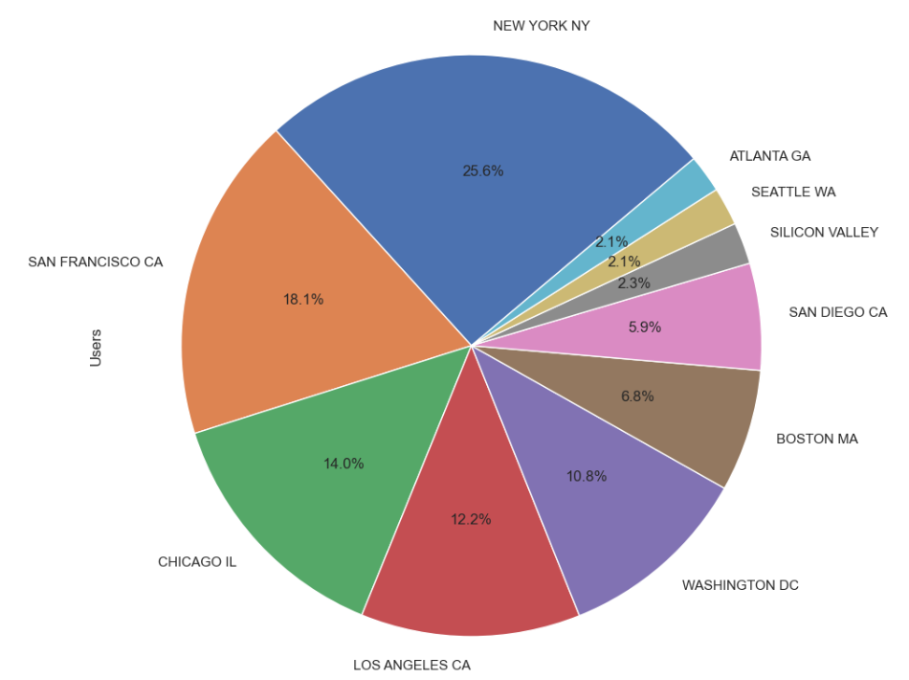
Users per City User presence city wise.
The majority of cab users are in New York City (25%), followed by San Francisco (18%), and Chicago (14%).
It is clear that New York city represents the largest portion of 25%.That is a quarter of the total.
San Francisco has the second-highest users, at 18.1 per cent. Chicago represents 11.7 per cent of the total. Los angeles is 12.2 per cent, followed closely by Washington DC at 10.8 per cent, and then Boston at 6.8 per cent.
The smallest users in terms of city are Atlanta, Seattle, Silicon. These cities have almost same amount of per cent.

Slide 17
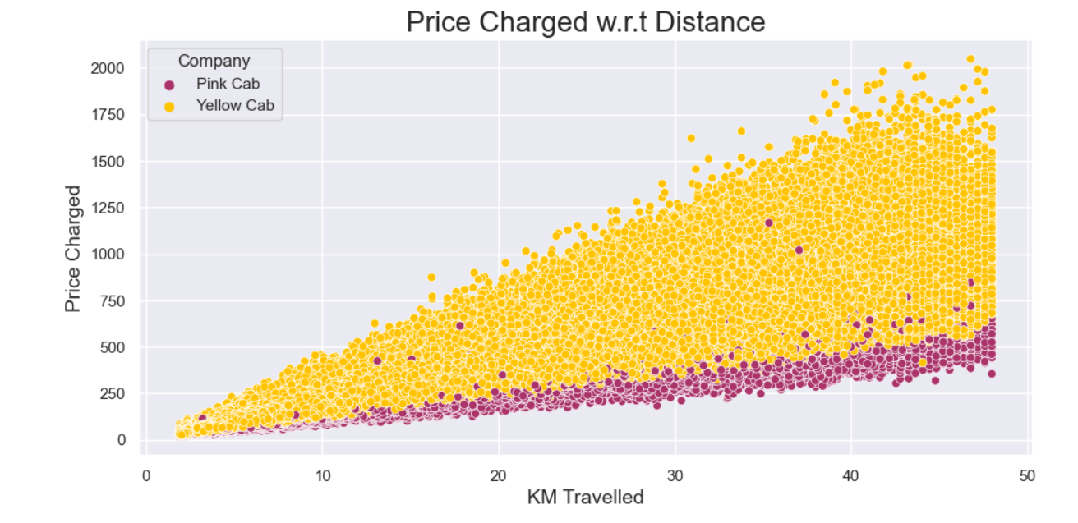
Price charged with respect to Distance
The scatter plot above demonstrates a linear relationship between the price charged and the distance travelled for both cab companies. Moreover, Yellow cabs are more expensive than Pink cabs.

Slide 18
Recommendations
Yellow Cab is noticeably earning much Profit than Pink Cab.
Yellow cab is preferred by the customers over Pink cab.
Yellow Cab is more popular than Pink Cab overall.
Therefore, Yellow cab would be the preferred one.

Slide 19


